Slide 1
C-CDA Documents: Building Blocks for Meaningful Exchange
Lisa Nelson, MS, MBA, Life Over Time Solutions
Notes:
C-CDA Documents: Buiding Blocks for Meaningful Exchange. An educational presentation brought to you by the HIMSS Health Story Project.
This educational resource is designed for a non-technical audience interested in gaining a deeper understanding of the HL7 Clinical Document Architecture standard (called CDA) and the types of CDA documents defined in the HL7 Consolidated CDA Release 2.1 Implementation Guide (called C-CDA for short).

Slide 2
Learning Objectives
Overview of HL7 CDA and C-CDA
Gain exposure to the HL7 Clinical Document Architecture standard
Understand the history of C-CDA
Learn about the different types in C-CDA R2.1
List the 12 document types and intended purposes
Explore the similarities and differences across document types
Discuss why using the right type of document improves information exchange
Review the types of information exchanged using C-CDA documents
Understand the sections required and optional sections defined for by each document type
Visualize the “Health Story” told by each document type
Learn what it means to be an Open Template in CDA
Compare and contrast different types of C-CDA documents
Visualize how C-CDA document exchange supports the Health IT ecosystem
Notes:
We will provide an overview of the CDA and C-CDA standards.
Discuss the different types of documents defined in C-CDA.
Compare two different ways of thinking about C-CDA documents: the current way which focuses on the sections of content that are required or optional, and a new way that focuses on the story-telling power of C-CDA documents,
And finally, we’ll take a big leap and discuss how CDA document exchange supports information flow within the broader Health IT ecosystem, to expand the understanding of the possibilities for meaningful information exchange through the use of CDA.

Slide 3

Lisa Nelson, MS, MBA
Principal Consultant Life Over Time Solutions
Over twenty years of experience in IT strategy, support, and systems consulting.
An independent consultant and an active member of HL7, participating in the Structured Documents, Patient Care and Templates Groups.
Also active in Integrating the Healthcare Enterprise (IHE)
Notes:
I’m Lisa Nelson, an independent consultant who specializes in the use and evolution of the CDA standard. I’ll be your guide through this presentation.

Slide 4
Understanding CDA and Consolidated CDA (C-CDA)
CCD
C
About
CDA
Discharge
Summary
History &
Physical
C
Consult
Note
About
C-CDA
Referral
Note
C-CDA
D
A
Data
Rich
STORY
Data in Motion
The Longitudinal View
Procedure
Note
Operative
Note
C-CDA
Doc
Types
Different
Transfer
Summary
SOAP
CCD
C-CDA
Health
Story
Framework
Use
Cases
Different
C-CDA
Care
Plan
Progress
Note
Lots of
Data
Required?
Notes:
The presentation you’re about to hear makes understanding CDA and C-CDA very straightforward. You will learn the key information you need to form a basic foundation of knowledge about the HL7 CDA standard and the Consolidated CDA Implementation Guide.

Slide 5

About HL7 Clinical Document Architecture Standard
Gain exposure to the HL7 Clinical Document Architecture standard
Notes:
We are going to start by talking about the HL7 Clinical Document Architecture standard. When people use the term “CDA” they are referring to this very broad, flexible “base standard” that was developed to address a wide range of data exchange use cases for all sorts of clinical documents.

Slide 6
Core Principles of the HL7 Clinical Document Architecture
Persistence – A clinical document continues to exist in an unaltered state, for a time period defined by local and regulatory requirements (NOTE: There is a distinct scope of persistence for a clinical document, independent of the persistence of any XML-encoded CDA document instance).
Stewardship – A clinical document is maintained by an organization entrusted with its care.
Potential for authentication - A clinical document is an assemblage of information that is intended to be legally authenticated.
Context - A clinical document establishes the default context for its contents.
Wholeness - Authentication of a clinical document applies to the whole and does not apply to portions of the document without the full context of the document.
Human readability – A clinical document is human readable.
Notes:
The HL7 Clinical Document Architecture standard support 6 Core Principles – and these are important to understand.
Persistence – each clinical document continues to exist in an unaltered state. (Business rules determine for how long, but what’s key is that the document itself must be accessible in an unaltered state.)
Stewardship – each clinical document is maintained by the organization entrusted with the responsibility of being the custodian for the document.
Potential for authentication – the assemblage of information in a clinical document has the potential to be legally authenticated. That is to say, it may not have been legally authenticated, but it must have the potential to be legally authenticated, should that be required.
Context – each CDA document establishes the context for the information contained within it.
Wholeness – authentication of a clinical document applies to the whole and does not apply to portions of the document separate from the full context of the document.
Human Readability – each clinical document is a human readable document. It may have machine readable information in it too, but first and foremost, the information is human readable.

Slide 7
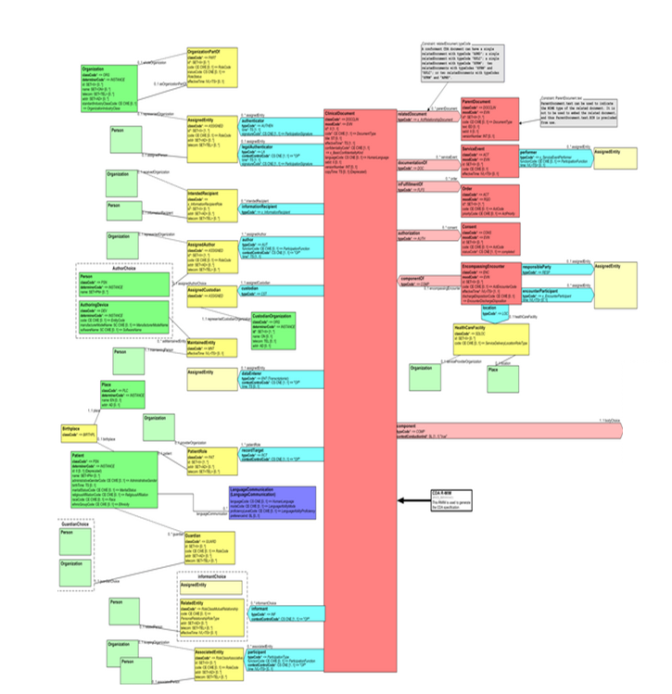
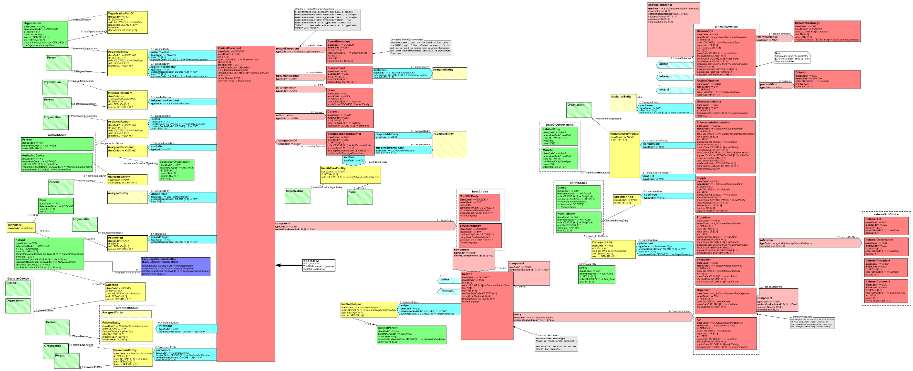
Similar Header for all CDA Documents
The context for each CDA Document is established in the header.
Participantations (9)
recordTarget (subject) – only one
author – can be more than one
Custodian – only one
Act Relationships (5)
encompassingEncounter
serviceEvent
order
relatedDocument
Header
Notes:
All CDA documents have a similarly structured header that prescribes what information can and needs to populated.
Many aspects of the header are optional, but every CDA Document contains information about the subject of the document, the authors, and the custodian.
The header may include information about the encompassing encounter, service events performed, or orders that were fulfilled, and consent that applied.
Information in the header establishes the context for the information in the body of the document.
If the information in one document replaces or appends to information in another document, the header includes a pointer to the related document or documents.

Slide 8

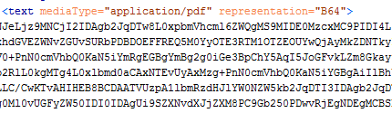
Structured vs Unstructured Documents
<clinicalDocument>
<recordTarget/>
<author/>
<custodian/>
<component>
<structuredBody>
<section/>
<section/>
<section/>
</structureBody>
</component>
</clinicalDocument>
<clinicalDocument>
<recordTarget/>
<author/>
<custodian/>
<component>
<nonXMLBody>
</nonXMLBody>
</component>
</clinicalDocument>
Notes:
Finally, the body of a CDA Document contains structured xml data or encoded data in a non-xml body which can be rendered digitally, but does not support computer processing in the same way that the structured xml data does. When the document has a coded body, a computer can process each individual section of information in the document. Further, the sections of the document may include individual structured entires that make it possible for a computer to process the information in each section. But don’t forget, first and foremost, the information contained in each section of the document is human readable.

Slide 9

About Consolidated CDA (C-CDA)
Understand the history of C-CDA
Notes:
Consolidated CDA is an HL7 Implementation Guide that explains how to use the base CDA standard to produce 12 different types of clinical documents.
The CDA Standard is very broad, to support all different types of clinical documents. Tighter constraints needed to be defined so that implementers would know how to use CDA to make a specific type of document like a Discharge Summary or Procedure Note.
The document template definition in C-CDA are made other templates that constrain sections, entries and other smaller parts of the CDA base standard. It’s a nesting desing that support the core principle of Context.

Slide 10
12 C-CDA R2.1 Document Types
Available in C-CDA R1.0/R1.1
New as of C-CDA R2.0
Consultation Note
Continuity of Care (CCD)
Diagnostic Imaging Report
Discharge Summary
History and Physical
Operative Note
Procedure Note
Progress Note
Unstructured Document
Care Plan
Referral Note
Transfer Summary
C
C
D
A
Notes:
This slide shows all 12 of the document types included in C-CDA Release 2.1
Three of the document templates are new for the industry. They were defined when C-CDA Release 2.0 was created.
The other document templates have been defined since C-CDA Release 1.0 was created.

Slide 11
History behind C-CDA Documents
Health Story Project CDA Implementation Guides
IG Name | Start Date | Publish Date
Continuity of Care Document (CCD) |  | 2007 Apr
Discharge Summary | 2009 Sep | 2009 Dec
Consultation Note | 2008 | 2010 Jan
History and Physical Note | 2008 Jul | 2010 Jan
Procedure Note | 2010 Jul | 2010 Jul
Unstructured Document |  | 2010 Dec
Consent Directive |  | 2011 Jan
Progress Note | 2010 Sep | 2011 Jan
Op Note | 2008 Oct | 2011 Jan
Notes:
Implementation guidance for many of the document templates dates back to work done several years ago by a group of vendors interested in leveraging the power of CDA for interoperabile information exchange.
That group became what we know today as the Health Story Project.

Slide 12



Consolidated CDA (C-CDA)
Healt Story Project Implementation Guides
C-CDA R1.0 (2011 Dec)
C-CDA R1.1 (2012 Jul)
C-CDA R2.0 (2014 Nov)
C-CDA R2.1 (2015 Aug)
C32, C83
PCC Medical Summary
C-CDA 1.0
Notes:
Consolidated CDA got its name because it was created as a harmonized set of CDA templates, consolidated from prior work that had been developed in IHE, HL7 and HITSP. The harmonized templates were aggregated into a single guide for greater standardization within the industry.

Slide 13
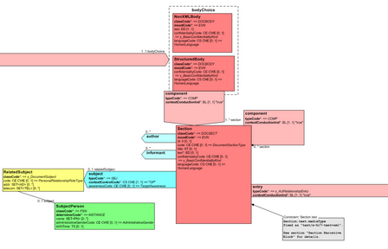
Similarities and Differences Across Different C-CDA Document Types
Differences in the headers support different use cases
Differences in the type of body
Differences in the types of sections in the structured body
Connection from the header
Act relationship connects a section to machine readable entries.
Humar readable text is contained within the section.text element.
Notes:
The 12 document templates share a fairly similar header though some of the document types have an encounter context and others do not. One document defines an “Unstructured Document” which is to say it uses the nonXMLBody option. The other documents have structured bodies, but the section content differs from one document type to another.
Some of the sections additionally have machine readable entries defined, making it possible to encode the human readable information in each section using a more machine-friendly format.

Slide 14
Common Set of Sections for Information Exchange
Anesthesia
Allergies & Intolerances
Advance directive
Admission Meds
Admission Diagnosis
Assessment & Plan
Assessment
Chief Complaint Reason for Visit
Chief Complaint
Complications
Course of Care
DICOM Object Catalog
Discharge Diagnosis
Discharge Diet
Discharge Medications
Encounters
Family History
Fetus Subject Context
Findings
Functional Status
General Status
Goals
Health Concerns
Health Status Eval/Outcomes
History Past Illness
Hospital Consultations
Hospital Course
Hospital Discharge Instructions
Hospital Discharge Physical
Hospital Discharge Studies Sum.
Immunizations
Implants
Instructions
Interventions
Medical (Gen) History
Medical Equipment
Medications Administered
Medications
Mental Status
Nutrition
Objective
Observer Context
Operative Note Fluids
Op Note Surgical Procedure
Payers
Physical Exam
Plan of Treatment
Planned Procedure
Postoperative Diagnosis
Postprocedure Diagnosis
Preoperative Diagnosis
Problem
Procedure Description
Procedure Disposition
Procedure Est. Blood Loss
Procedure Findings
Procedure Implants
Procedure Indications
Procedure Specimens
Procedures
Reason for Referral
Reason for Visit
Results
Review of Systems
Social History
Subjective
Surgery Description
Surgical Drains
Vital Signs
History Present Illness
Notes:
Many of the 70 different section templates defined in Consolidated CDA are used across more than one of the twelve document types.
This makes the information shared through the C-CDA documents more meaningful and interchangeable.
For example the Problems section is used in almost all of the document templates. That means if a person had a new condition on his or her problem list when discharged from the hospital, the problem expressed in the C-CDA Discharge Summary document is fully interoperable with the problem information aggrecated in a Continuity of Care Document used to summarize that person’s health and care over time.

Slide 15
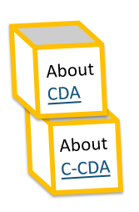
Learning Objectives
What is the difference between CDA and C-CDA?
What is the difference between C-CDA and CCD?
Notes:
I’ll close this portion of the presentation by checking to see if you can summarize the difference between CDA and C-CDA? And to see if you can explain the difference between C-CDA and CCD?

Slide 16
Learning Objectives
What is the difference between CDA and C-CDA?
CDA is the base HL7 Clinical Document Architecture Standard. The CDA standard is very broad and templates are used to constrain the standard for specific uses.
C-CDA is an HL7 Implementation Guide (IG) that defines a set of templates that constrain CDA for the purpose of specifying 12 different commonly used document types. C-CDA stands for Consolidated CDA.
What is the difference between C-CDA and CCD?
C-CDA is an IG that defines 12 different types of CDA documents. CCD is one type of CDA document defined in the C-CDA IG. CCD stands for Continuity of Care Document.
Notes:
If you said that CDA is the broad-based HL7 standard called Clinical Document Architecture while C-CDA is an HL7 Implementation Guide that defines different types of CDA documents intended to support different use cases, you were right. You’ve been listening. Good for you!
If you said C-CDA is an IG that defines 12 different document types while CCD is one type of document called the Continuity of Care Document, then you get a gold star!
Feeling confident this isn’t so too hard to understand? Good.
Are you ready to learn more about the different document types defined in C-CDA?

Slide 17
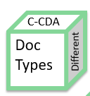
Different Document Types
List the 12 document types in C-CDA R2.1 and intended purpose

Slide 18
Why are there different document types?
Documents need to fit the situation
Share information that is relevant and pertinent
Establish the right context for the information being shared
Information about multiple encounters
Information about a single encounter
Information about a service(s) within an encounter
Information that is related to a specific order
Patient generated information vs Clinician or System generated information
Each CDA Document is designed to address a specific purpose.

Slide 19
C-CDA: Exchanging the Patient’s Story
Primary Care Provider
Imaging Center
Orthopedic Surgeon
Surgery Center
Orthopedic Surgeon
Referral Note
History & Physical
Procedure Note
History & Physical
Diagnostic Imaging Report
Consult Note
Discharge Summary
Progress Note
CCD
CCD
CCD
CCD

Slide 20
C-CDA: Exchanging the Patient’s Story
Primary Care Provider
Physical Therapy
Physical Therapy
Physical Therapy
Physical Therapy
Primary Care Provider
Referral Note
History & Physical
Consultation Note
Progress Note
Progress Note
Progress Note
History & Physical
CCD
CCD
CCD
CCD

Slide 21
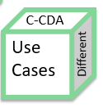
Different Use Cases
Understand the purpose for each document type

Slide 22
C-CDA R2.1 Document Types and intended purpose
Document type | Pupose
Consultation Note | Describes the findings and treatment recommendations of a consulting physician, often written as a letter to the referring physician. Used to close the loop on a referral or to keep referring/primary physician informed about findings, assessments, and treatment plan.
Discharge Summary | Written at the time of discharge from an acute care hospital involving stays greater than 24 hours. Summarizes reason for hospital stay, findings, procedures, treatments, medications and ongoing care instructions. A critical document for continuity of care for patients moving to another care facility or back to the care of outpatient physicians.
Diagnostic Imaging Report | Report written by radiologist with findings of a diagnostic imaging study such as x-ray, MRI, or CT.
History and Physical | Comprehensive report of subjective and objective findings, assessment and treatment plan. Required within 24 hours of hospital admission and typically written on a patient's initial outpatient encounter with a physician and again at yearly physical.
Operative Note | Documents a surgical procedure, including indication for surgery, anesthesia, details of the procedure, complications, and disposition of the patient at the end of the operation.
Procedure Note | Documents a procedure, typically less involved than a surgical operation, such as outpatient injections.
Progress Note | In an acute care setting, progress notes are written daily. In the outpatient setting, progress notes are written for followup or recheck appointments. Progress notes often follow the SOAP format (Subjective, Objective, Assessment, and Plan).
Available in C-CDA R1.0/R1.1
New as of C-CDA R2.0

Slide 23

C-CDA R2.1 Document Types and intended purpose
Document type | Pupose
Continuity of Care (CCD) | The Continuity of Care Document (CCD) represents a core data set of the most relevant administrative, demographic, and clinical information facts about a patient's healthcare, covering one or more healthcare encounters. It provides a means for one healthcare practitioner, system, or setting to aggregate all of the pertinent data about a patient and forward it to another to support the continuity of care. The primary use case for the CCD is to provide a snapshot in time containing the germane clinical, demographic, and administrative data for a specific patient. The key characteristic of a CCD is that the ServiceEvent is constrained to "PCPR". This means it does not function to report new ServiceEvents associated with performing care. It reports on care that has already been provided. The CCD provides a historical tally of the care over a range of time and is not a record of new services delivered.
Referral Note | A Referral Note communicates pertinent information from a provider who is requesting services of another provider of clinical or non-clinical services.
Transfer Summary | The Transfer Summary standardizes critical information for exchange of information between providers of care when a patient moves between health care settings.
Care Plan | The CDA Care Plan represents an instance of a person’s dynamic Care Plan at a point in time. The CDA document itself is NOT dynamic.
Unstructured Document | An Unstructured Document (UD) document type can (1) include unstructured content, such as a graphic, directly in a text element with a mediaType attribute, or (2) reference a single document file, such as a word-processing document using a text/reference element. This Unstructured Documents template is applicable not only for scanned documents in non-PDF formats, but also for clinical documents produced through word processing applications, etc.
Available in C-CDA R1.0/R1.1
New as of C-CDA R2.0

Slide 24
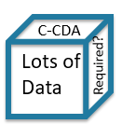
Making Sense of C-CDA Documents
Alphabetical order, why not?

Slide 25
C-CDA R2.1 Sections - Alphabetical Order
Old Way of Understanding C-CDA
Anesthesia
Allergies & Intolerances
Advance directive
Admission Meds
Admission Diagnosis
Assessment & Plan
Assessment
Chief Complaint Reason for Visit
Chief Complaint
Complications
Course of Care
DICOM Object Catalog
Discharge Diagnosis
Discharge Diet
Discharge Medications
Encounters
Family History
Fetus Subject Context
Findings
Functional Status
General Status
Goals
Health Concerns
Health Status Eval/Outcomes
History Past Illness
Hospital Consultations
Hospital Course
Hospital Discharge Instructions
Hospital Discharge Physical
Hospital Discharge Studies Sum.
Immunizations
Implants
Instructions
Interventions
Medical (Gen) History
Medical Equipment
Medications Administered
Medications
Mental Status
Nutrition
Objective
Observer Context
Operative Note Fluids
Op Note Surgical Procedure
Payers
Physical Exam
Plan of Treatment
Planned Procedure
Postoperative Diagnosis
Postprocedure Diagnosis
Preoperative Diagnosis
Problem
Procedure Description
Procedure Disposition
Procedure Est. Blood Loss
Procedure Findings
Procedure Implants
Procedure Indications
Procedure Specimens
Procedures
Reason for Referral
Reason for Visit
Results
Review of Systems
Social History
Subjective
Surgery Description
Surgical Drains
Vital Signs
History Present Illness

Slide 26
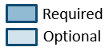
Required
Care Plan
Optional
Anesthesia
Allergies & Intolerances
Advance directive
Admission Meds
Admission Diagnosis
Assessment & Plan
Assessment
Chief Complaint Reason for Visit
Chief Complaint
Complications
Course of Care
DICOM Object Catalog
Discharge Diagnosis
Discharge Diet
Discharge Medications
Encounters
Family History
Fetus Subject Context
Findings
Functional Status
General Status
Goals
Health Concerns
Health Status Eval/Outcomes
History Past Illness
Hospital Consultations
Hospital Course
Hospital Discharge Instructions
Hospital Discharge Physical
Hospital Discharge Studies Sum.
Immunizations
Implants
Instructions
Interventions
Medical (Gen) History
Medical Equipment
Medications Administered
Medications
Mental Status
Nutrition
Objective
Observer Context
Operative Note Fluids
Op Note Surgical Procedure
Payers
Physical Exam
Plan of Treatment
Planned Procedure
Postoperative Diagnosis
Postprocedure Diagnosis
Preoperative Diagnosis
Problem
Procedure Description
Procedure Disposition
Procedure Est. Blood Loss
Procedure Findings
Procedure Implants
Procedure Indications
Procedure Specimens
Procedures
Reason for Referral
Reason for Visit
Results
Review of Systems
Social History
Subjective
Surgery Description
Surgical Drains
Vital Signs
History Present Illness

Slide 27
Required
Consultation Note
Optional
Anesthesia
Allergies & Intolerances
Advance directive
Admission Meds
Admission Diagnosis
Assessment & Plan
Assessment
Chief Complaint Reason for Visit
Chief Complaint
Complications
Course of Care
DICOM Object Catalog
Discharge Diagnosis
Discharge Diet
Discharge Medications
Encounters
Family History
Fetus Subject Context
Findings
Functional Status
General Status
Goals
Health Concerns
Health Status Eval/Outcomes
History Past Illness
Hospital Consultations
Hospital Course
Hospital Discharge Instructions
Hospital Discharge Physical
Hospital Discharge Studies Sum.
Immunizations
Implants
Instructions
Interventions
Medical (Gen) History
Medical Equipment
Medications Administered
Medications
Mental Status
Nutrition
Objective
Observer Context
Operative Note Fluids
Op Note Surgical Procedure
Payers
Physical Exam
Plan of Treatment
Planned Procedure
Postoperative Diagnosis
Postprocedure Diagnosis
Preoperative Diagnosis
Problem
Procedure Description
Procedure Disposition
Procedure Est. Blood Loss
Procedure Findings
Procedure Implants
Procedure Indications
Procedure Specimens
Procedures
Reason for Referral
Reason for Visit
Results
Review of Systems
Social History
Subjective
Surgery Description
Surgical Drains
Vital Signs
History Present Illness

Slide 28
Required
Continuity of Care Document
Optional
Anesthesia
Allergies & Intolerances
Advance directive
Admission Meds
Admission Diagnosis
Assessment & Plan
Assessment
Chief Complaint Reason for Visit
Chief Complaint
Complications
Course of Care
DICOM Object Catalog
Discharge Diagnosis
Discharge Diet
Discharge Medications
Encounters
Family History
Fetus Subject Context
Findings
Functional Status
General Status
Goals
Health Concerns
Health Status Eval/Outcomes
History Past Illness
Hospital Consultations
Hospital Course
Hospital Discharge Instructions
Hospital Discharge Physical
Hospital Discharge Studies Sum.
Immunizations
Implants
Instructions
Interventions
Medical (Gen) History
Medical Equipment
Medications Administered
Medications
Mental Status
Nutrition
Objective
Observer Context
Operative Note Fluids
Op Note Surgical Procedure
Payers
Physical Exam
Plan of Treatment
Planned Procedure
Postoperative Diagnosis
Postprocedure Diagnosis
Preoperative Diagnosis
Problem
Procedure Description
Procedure Disposition
Procedure Est. Blood Loss
Procedure Findings
Procedure Implants
Procedure Indications
Procedure Specimens
Procedures
Reason for Referral
Reason for Visit
Results
Review of Systems
Social History
Subjective
Surgery Description
Surgical Drains
Vital Signs
History Present Illness

Slide 29
Required
Discharge Summary
Optional
Anesthesia
Allergies & Intolerances
Advance directive
Admission Meds
Admission Diagnosis
Assessment & Plan
Assessment
Chief Complaint Reason for Visit
Chief Complaint
Complications
Course of Care
DICOM Object Catalog
Discharge Diagnosis
Discharge Diet
Discharge Medications
Encounters
Family History
Fetus Subject Context
Findings
Functional Status
General Status
Goals
Health Concerns
Health Status Eval/Outcomes
History Past Illness
Hospital Consultations
Hospital Course
Hospital Discharge Instructions
Hospital Discharge Physical
Hospital Discharge Studies Sum.
Immunizations
Implants
Instructions
Interventions
Medical (Gen) History
Medical Equipment
Medications Administered
Medications
Mental Status
Nutrition
Objective
Observer Context
Operative Note Fluids
Op Note Surgical Procedure
Payers
Physical Exam
Plan of Treatment
Planned Procedure
Postoperative Diagnosis
Postprocedure Diagnosis
Preoperative Diagnosis
Problem
Procedure Description
Procedure Disposition
Procedure Est. Blood Loss
Procedure Findings
Procedure Implants
Procedure Indications
Procedure Specimens
Procedures
Reason for Referral
Reason for Visit
Results
Review of Systems
Social History
Subjective
Surgery Description
Surgical Drains
Vital Signs
History Present Illness

Slide 30
Required
History & Physical
Optional
Anesthesia
Allergies & Intolerances
Advance directive
Admission Meds
Admission Diagnosis
Assessment & Plan
Assessment
Chief Complaint Reason for Visit
Chief Complaint
Complications
Course of Care
DICOM Object Catalog
Discharge Diagnosis
Discharge Diet
Discharge Medications
Encounters
Family History
Fetus Subject Context
Findings
Functional Status
General Status
Goals
Health Concerns
Health Status Eval/Outcomes
History Past Illness
Hospital Consultations
Hospital Course
Hospital Discharge Instructions
Hospital Discharge Physical
Hospital Discharge Studies Sum.
Immunizations
Implants
Instructions
Interventions
Medical (Gen) History
Medical Equipment
Medications Administered
Medications
Mental Status
Nutrition
Objective
Observer Context
Operative Note Fluids
Op Note Surgical Procedure
Payers
Physical Exam
Plan of Treatment
Planned Procedure
Postoperative Diagnosis
Postprocedure Diagnosis
Preoperative Diagnosis
Problem
Procedure Description
Procedure Disposition
Procedure Est. Blood Loss
Procedure Findings
Procedure Implants
Procedure Indications
Procedure Specimens
Procedures
Reason for Referral
Reason for Visit
Results
Review of Systems
Social History
Subjective
Surgery Description
Surgical Drains
Vital Signs
History Present Illness

Slide 31
Required
Operative Note
Optional
Anesthesia
Allergies & Intolerances
Advance directive
Admission Meds
Admission Diagnosis
Assessment & Plan
Assessment
Chief Complaint Reason for Visit
Chief Complaint
Complications
Course of Care
DICOM Object Catalog
Discharge Diagnosis
Discharge Diet
Discharge Medications
Encounters
Family History
Fetus Subject Context
Findings
Functional Status
General Status
Goals
Health Concerns
Health Status Eval/Outcomes
History Past Illness
Hospital Consultations
Hospital Course
Hospital Discharge Instructions
Hospital Discharge Physical
Hospital Discharge Studies Sum.
Immunizations
Implants
Instructions
Interventions
Medical (Gen) History
Medical Equipment
Medications Administered
Medications
Mental Status
Nutrition
Objective
Observer Context
Operative Note Fluids
Op Note Surgical Procedure
Payers
Physical Exam
Plan of Treatment
Planned Procedure
Postoperative Diagnosis
Postprocedure Diagnosis
Preoperative Diagnosis
Problem
Procedure Description
Procedure Disposition
Procedure Est. Blood Loss
Procedure Findings
Procedure Implants
Procedure Indications
Procedure Specimens
Procedures
Reason for Referral
Reason for Visit
Results
Review of Systems
Social History
Subjective
Surgery Description
Surgical Drains
Vital Signs
History Present Illness

Slide 32
Required
Procedure Notes
Optional
Anesthesia
Allergies & Intolerances
Advance directive
Admission Meds
Admission Diagnosis
Assessment & Plan
Assessment
Chief Complaint Reason for Visit
Chief Complaint
Complications
Course of Care
DICOM Object Catalog
Discharge Diagnosis
Discharge Diet
Discharge Medications
Encounters
Family History
Fetus Subject Context
Findings
Functional Status
General Status
Goals
Health Concerns
Health Status Eval/Outcomes
History Past Illness
Hospital Consultations
Hospital Course
Hospital Discharge Instructions
Hospital Discharge Physical
Hospital Discharge Studies Sum.
Immunizations
Implants
Instructions
Interventions
Medical (Gen) History
Medical Equipment
Medications Administered
Medications
Mental Status
Nutrition
Objective
Observer Context
Operative Note Fluids
Op Note Surgical Procedure
Payers
Physical Exam
Plan of Treatment
Planned Procedure
Postoperative Diagnosis
Postprocedure Diagnosis
Preoperative Diagnosis
Problem
Procedure Description
Procedure Disposition
Procedure Est. Blood Loss
Procedure Findings
Procedure Implants
Procedure Indications
Procedure Specimens
Procedures
Reason for Referral
Reason for Visit
Results
Review of Systems
Social History
Subjective
Surgery Description
Surgical Drains
Vital Signs
History Present Illness

Slide 33
Required
Progress Note
Optional
Anesthesia
Allergies & Intolerances
Advance directive
Admission Meds
Admission Diagnosis
Assessment & Plan
Assessment
Chief Complaint Reason for Visit
Chief Complaint
Complications
Course of Care
DICOM Object Catalog
Discharge Diagnosis
Discharge Diet
Discharge Medications
Encounters
Family History
Fetus Subject Context
Findings
Functional Status
General Status
Goals
Health Concerns
Health Status Eval/Outcomes
History Past Illness
Hospital Consultations
Hospital Course
Hospital Discharge Instructions
Hospital Discharge Physical
Hospital Discharge Studies Sum.
Immunizations
Implants
Instructions
Interventions
Medical (Gen) History
Medical Equipment
Medications Administered
Medications
Mental Status
Nutrition
Objective
Observer Context
Operative Note Fluids
Op Note Surgical Procedure
Payers
Physical Exam
Plan of Treatment
Planned Procedure
Postoperative Diagnosis
Postprocedure Diagnosis
Preoperative Diagnosis
Problem
Procedure Description
Procedure Disposition
Procedure Est. Blood Loss
Procedure Findings
Procedure Implants
Procedure Indications
Procedure Specimens
Procedures
Reason for Referral
Reason for Visit
Results
Review of Systems
Social History
Subjective
Surgery Description
Surgical Drains
Vital Signs
History Present Illness

Slide 34
Required
Referral Note
Optional
Anesthesia
Allergies & Intolerances
Advance directive
Admission Meds
Admission Diagnosis
Assessment & Plan
Assessment
Chief Complaint Reason for Visit
Chief Complaint
Complications
Course of Care
DICOM Object Catalog
Discharge Diagnosis
Discharge Diet
Discharge Medications
Encounters
Family History
Fetus Subject Context
Findings
Functional Status
General Status
Goals
Health Concerns
Health Status Eval/Outcomes
History Past Illness
Hospital Consultations
Hospital Course
Hospital Discharge Instructions
Hospital Discharge Physical
Hospital Discharge Studies Sum.
Immunizations
Implants
Instructions
Interventions
Medical (Gen) History
Medical Equipment
Medications Administered
Medications
Mental Status
Nutrition
Objective
Observer Context
Operative Note Fluids
Op Note Surgical Procedure
Payers
Physical Exam
Plan of Treatment
Planned Procedure
Postoperative Diagnosis
Postprocedure Diagnosis
Preoperative Diagnosis
Problem
Procedure Description
Procedure Disposition
Procedure Est. Blood Loss
Procedure Findings
Procedure Implants
Procedure Indications
Procedure Specimens
Procedures
Reason for Referral
Reason for Visit
Results
Review of Systems
Social History
Subjective
Surgery Description
Surgical Drains
Vital Signs
History Present Illness

Slide 35
Transfer Summary
Anesthesia
Allergies & Intolerances
Advance directive
Admission Meds
Admission Diagnosis
Assessment & Plan
Assessment
Chief Complaint Reason for Visit
Chief Complaint
Complications
Course of Care
DICOM Object Catalog
Discharge Diagnosis
Discharge Diet
Discharge Medications
Encounters
Family History
Fetus Subject Context
Findings
Functional Status
General Status
Goals
Health Concerns
Health Status Eval/Outcomes
History Past Illness
Hospital Consultations
Hospital Course
Hospital Discharge Instructions
Hospital Discharge Physical
Hospital Discharge Studies Sum.
Immunizations
Implants
Instructions
Interventions
Medical (Gen) History
Medical Equipment
Medications Administered
Medications
Mental Status
Nutrition
Objective
Observer Context
Operative Note Fluids
Op Note Surgical Procedure
Payers
Physical Exam
Plan of Treatment
Planned Procedure
Postoperative Diagnosis
Postprocedure Diagnosis
Preoperative Diagnosis
Problem
Procedure Description
Procedure Disposition
Procedure Est. Blood Loss
Procedure Findings
Procedure Implants
Procedure Indications
Procedure Specimens
Procedures
Reason for Referral
Reason for Visit
Results
Review of Systems
Social History
Subjective
Surgery Description
Surgical Drains
Vital Signs
History Present Illness

Slide 36

Making Sense of C-CDA Documents
Using SOAP as a story-telling framework

Slide 37
SOAP Notes: A Standardized Story-Telling Format
The SOAP note (an acronym for subjective, objective, assessment, and plan) is a method of documentation employed by health care providers to write out notes in a patient's chart.
Documenting patient encounters in the medical record is an integral part of practice workflow starting with patient appointment scheduling, to writing out notes, to medical billing.
The SOAP note originated from the Problem Oriented Medical Record (POMR), developed by Lawrence Weed, MD.
It was initially developed for physicians, who at the time, were the only health care providers allowed to write in a medical record.
Today, it is widely adopted as a communication tool between inter-disciplinary healthcare providers as a way to document a patient’s progress.
SOAP notes are now commonly found in electronic medical records (EMR) and are used by providers of various backgrounds.
Prehospital care providers such as EMTs may use the same format to communicate patient information to emergency department clinicians.
Physicians, physician assistants, nurse practitioners, pharmacists, podiatrists, chiropractors, acupuncturists, occupational therapists, physical therapists, school psychologists, speech-language pathologists, certified athletic trainers (ATC), sports therapists, occupational therapists, among other providers use this format for the patient's initial visit and to monitor progress during follow-up care.
https://en.wikipedia.org/wiki/SOAP_note

Slide 38
Subjective Section Templates
Anesthesia
Allergies & Intolerances
Advance directive
Admission Meds
Admission Diagnosis
Assessment & Plan
Assessment
Chief Complaint Reason for Visit
Chief Complaint
Complications
Course of Care
DICOM Object Catalog
Discharge Diagnosis
Discharge Diet
Discharge Medications
Encounters
Family History
Fetus Subject Context
Findings
Functional Status
General Status
Goals
Health Concerns
Health Status Eval/Outcomes
History Past Illness
Hospital Consultations
Hospital Course
Hospital Discharge Instructions
Hospital Discharge Physical
Hospital Discharge Studies Sum.
Immunizations
Implants
Instructions
Interventions
Medical (Gen) History
Medical Equipment
Medications Administered
Medications
Mental Status
Nutrition
Objective
Observer Context
Operative Note Fluids
Op Note Surgical Procedure
Payers
Physical Exam
Plan of Treatment
Planned Procedure
Postoperative Diagnosis
Postprocedure Diagnosis
Preoperative Diagnosis
Problem
Procedure Description
Procedure Disposition
Procedure Est. Blood Loss
Procedure Findings
Procedure Implants
Procedure Indications
Procedure Specimens
Procedures
Reason for Referral
Reason for Visit
Results
Review of Systems
Social History
Subjective
Surgery Description
Surgical Drains
Vital Signs
History Present Illness

Slide 39
Objective Section Templates
Anesthesia
Allergies & Intolerances
Advance directive
Admission Meds
Admission Diagnosis
Assessment & Plan
Assessment
Chief Complaint Reason for Visit
Chief Complaint
Complications
Course of Care
DICOM Object Catalog
Discharge Diagnosis
Discharge Diet
Discharge Medications
Encounters
Family History
Fetus Subject Context
Findings
Functional Status
General Status
Goals
Health Concerns
Health Status Eval/Outcomes
History Past Illness
Hospital Consultations
Hospital Course
Hospital Discharge Instructions
Hospital Discharge Physical
Hospital Discharge Studies Sum.
Immunizations
Implants
Instructions
Interventions
Medical (Gen) History
Medical Equipment
Medications Administered
Medications
Mental Status
Nutrition
Objective
Observer Context
Operative Note Fluids
Op Note Surgical Procedure
Payers
Physical Exam
Plan of Treatment
Planned Procedure
Postoperative Diagnosis
Postprocedure Diagnosis
Preoperative Diagnosis
Problem
Procedure Description
Procedure Disposition
Procedure Est. Blood Loss
Procedure Findings
Procedure Implants
Procedure Indications
Procedure Specimens
Procedures
Reason for Referral
Reason for Visit
Results
Review of Systems
Social History
Subjective
Surgery Description
Surgical Drains
Vital Signs
History Present Illness

Slide 40
Assessment Section Templates
Anesthesia
Allergies & Intolerances
Advance directive
Admission Meds
Admission Diagnosis
Assessment & Plan
Assessment
Chief Complaint Reason for Visit
Chief Complaint
Complications
Course of Care
DICOM Object Catalog
Discharge Diagnosis
Discharge Diet
Discharge Medications
Encounters
Family History
Fetus Subject Context
Findings
Functional Status
General Status
Goals
Health Concerns
Health Status Eval/Outcomes
History Past Illness
Hospital Consultations
Hospital Course
Hospital Discharge Instructions
Hospital Discharge Physical
Hospital Discharge Studies Sum.
Immunizations
Implants
Instructions
Interventions
Medical (Gen) History
Medical Equipment
Medications Administered
Medications
Mental Status
Nutrition
Objective
Observer Context
Operative Note Fluids
Op Note Surgical Procedure
Payers
Physical Exam
Plan of Treatment
Planned Procedure
Postoperative Diagnosis
Postprocedure Diagnosis
Preoperative Diagnosis
Problem
Procedure Description
Procedure Disposition
Procedure Est. Blood Loss
Procedure Findings
Procedure Implants
Procedure Indications
Procedure Specimens
Procedures
Reason for Referral
Reason for Visit
Results
Review of Systems
Social History
Subjective
Surgery Description
Surgical Drains
Vital Signs
History Present Illness

Slide 41
Plan Section Templates
Anesthesia
Allergies & Intolerances
Advance directive
Admission Meds
Admission Diagnosis
Assessment & Plan
Assessment
Chief Complaint Reason for Visit
Chief Complaint
Complications
Course of Care
DICOM Object Catalog
Discharge Diagnosis
Discharge Diet
Discharge Medications
Encounters
Family History
Fetus Subject Context
Findings
Functional Status
General Status
Goals
Health Concerns
Health Status Eval/Outcomes
History Past Illness
Hospital Consultations
Hospital Course
Hospital Discharge Instructions
Hospital Discharge Physical
Hospital Discharge Studies Sum.
Immunizations
Implants
Instructions
Interventions
Medical (Gen) History
Medical Equipment
Medications Administered
Medications
Mental Status
Nutrition
Objective
Observer Context
Operative Note Fluids
Op Note Surgical Procedure
Payers
Physical Exam
Plan of Treatment
Planned Procedure
Postoperative Diagnosis
Postprocedure Diagnosis
Preoperative Diagnosis
Problem
Procedure Description
Procedure Disposition
Procedure Est. Blood Loss
Procedure Findings
Procedure Implants
Procedure Indications
Procedure Specimens
Procedures
Reason for Referral
Reason for Visit
Results
Review of Systems
Social History
Subjective
Surgery Description
Surgical Drains
Vital Signs
History Present Illness

Slide 42
Challenging Sections for SOAP Perspective
Anesthesia
Allergies & Intolerances
Advance directive
Admission Meds
Admission Diagnosis
Assessment & Plan
Assessment
Chief Complaint Reason for Visit
Chief Complaint
Complications
Course of Care
DICOM Object Catalog
Discharge Diagnosis
Discharge Diet
Discharge Medications
Encounters
Family History
Fetus Subject Context
Findings
Functional Status
General Status
Goals
Health Concerns
Health Status Eval/Outcomes
History Past Illness
Hospital Consultations
Hospital Course
Hospital Discharge Instructions
Hospital Discharge Physical
Hospital Discharge Studies Sum.
Immunizations
Implants
Instructions
Interventions
Medical (Gen) History
Medical Equipment
Medications Administered
Medications
Mental Status
Nutrition
Objective
Observer Context
Operative Note Fluids
Op Note Surgical Procedure
Payers
Physical Exam
Plan of Treatment
Planned Procedure
Postoperative Diagnosis
Postprocedure Diagnosis
Preoperative Diagnosis
Problem
Procedure Description
Procedure Disposition
Procedure Est. Blood Loss
Procedure Findings
Procedure Implants
Procedure Indications
Procedure Specimens
Procedures
Reason for Referral
Reason for Visit
Results
Review of Systems
Social History
Subjective
Surgery Description
Surgical Drains
Vital Signs
History Present Illness

Slide 43
C-CDA R2.1 Templates – SOAP Perspective
New Way of Understanding C-CDA
Anesthesia
Allergies & Intolerances
Advance directive
Admission Meds
Admission Diagnosis
Assessment & Plan
Assessment
Chief Complaint Reason for Visit
Chief Complaint
Complications
Course of Care
Discharge Diagnosis
Discharge Diet
Discharge Medications
Encounters
Family History
Findings
Functional Status
General Status
Goals
Health Concerns
Health Status Eval/Outcomes
History Past Illness
Hospital Consultations
Hospital Course
Hospital Discharge Instructions
Hospital Discharge Physical
Hospital Discharge Studies Sum.
Immunizations
Implants
Instructions
Medical (Gen) History
Medical Equipment
Medications Administered
Medications
Mental Status
Nutrition
Objective
Operative Note Fluids
Op Note Surgical Procedure
Payers
Physical Exam
Plan of Treatment
Planned Procedure
Postoperative Diagnosis
Postprocedure Diagnosis
Preoperative Diagnosis
Problem
Procedure Description
Procedure Disposition
Procedure Est. Blood Loss
Procedure Findings
Procedure Implants
Procedure Indications
Procedure Specimens
Procedures
Reason for Referral
Reason for Visit
Results
Review of Systems
Social History
Subjective
Surgery Description
Surgical Drains
Vital Signs
History Present Illness

Slide 44
C-CDA R2.1 Templates
Reorganized Using a SOAP Framework
Findings
Functional Status
General Status
Health Status Eval/Outcomes
Mental Status
Nutrition
Plan of Treatment
Planned Procedure
Subjective
Admission Diagnosis
Chief Complaint Reason for Visit
Chief Complaint
Reason for Visit
Health Concerns
History Present Illness
Objective
Problem
Results
Vital Signs
Medications
Immunizations
Medical (Gen) History
Procedures
Admission Meds
Medical Equipment
Implants
Course of Care
Hospital Course
Hospital Consultations
Medications Administered
Op Note Surgical Procedure
Procedure Description
Complications
Operative Note Fluids
Procedure Est. Blood Loss
Procedure Findings
Procedure Implants
Procedure Specimens
Procedure Disposition
Anesthesia
Surgery Description
Surgical Drains
Hospital Discharge Studies Sum
Hospital Discharge Physical
Goals
Physical Exam
Instructions
Discharge Medications
Hospital Discharge Instructions
Discharge Diet
Postprocedure Diagnosis
Discharge Diagnosis
Postoperative Diagnosis
Advance Directives
Payers
Encounters
Preoperative Diagnosis
Reason for Referral
Allergies & Intolerances
History Past Illness
Family History
Social History
Review of Systems
Assessment
Assessment & Plan
Procedure Indications

Slide 45

C-CDA Documents: Meaningful Patient Stories
Making sense out of C-CDA Documents

Slide 46
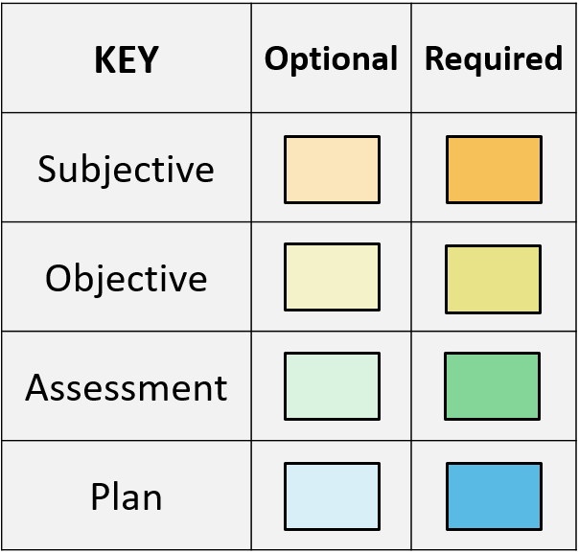
Continuity of Care Document (CCD) Story
Findings
Functional Status
General Status
Health Status Eval/Outcomes
Mental Status
Nutrition
Plan of Treatment
Planned Procedure
Subjective
Admission Diagnosis
Chief Complaint Reason for Visit
Chief Complaint
Reason for Visit
Health Concerns
History Present Illness
Objective
Problem
Results
Vital Signs
Medications
Immunizations
Medical (Gen) History
Procedures
Admission Meds
Medical Equipment
Implants
Course of Care
Hospital Course
Hospital Consultations
Medications Administered
Op Note Surgical Procedure
Procedure Description
Complications
Operative Note Fluids
Procedure Est. Blood Loss
Procedure Findings
Procedure Implants
Procedure Specimens
Procedure Disposition
Anesthesia
Surgery Description
Surgical Drains
Hospital Discharge Studies Sum
Hospital Discharge Physical
Goals
Physical Exam
Instructions
Discharge Medications
Hospital Discharge Instructions
Discharge Diet
Postprocedure Diagnosis
Discharge Diagnosis
Postoperative Diagnosis
Advance Directives
Payers
Encounters
Preoperative Diagnosis
Reason for Referral
Allergies & Intolerances
History Past Illness
Family History
Social History
Review of Systems
Assessment
Assessment & Plan
Procedure Indications

Slide 47
Discharge Summary Story
Findings
Functional Status
General Status
Health Status Eval/Outcomes
Mental Status
Nutrition
Plan of Treatment
Planned Procedure
Subjective
Admission Diagnosis
Chief Complaint Reason for Visit
Chief Complaint
Reason for Visit
Health Concerns
History Present Illness
Objective
Problem
Results
Vital Signs
Medications
Immunizations
Medical (Gen) History
Procedures
Admission Meds
Medical Equipment
Implants
Course of Care
Hospital Course
Hospital Consultations
Medications Administered
Op Note Surgical Procedure
Procedure Description
Complications
Operative Note Fluids
Procedure Est. Blood Loss
Procedure Findings
Procedure Implants
Procedure Specimens
Procedure Disposition
Anesthesia
Surgery Description
Surgical Drains
Hospital Discharge Studies Sum
Hospital Discharge Physical
Goals
Physical Exam
Instructions
Discharge Medications
Hospital Discharge Instructions
Discharge Diet
Postprocedure Diagnosis
Discharge Diagnosis
Postoperative Diagnosis
Advance Directives
Payers
Encounters
Preoperative Diagnosis
Reason for Referral
Allergies & Intolerances
History Past Illness
Family History
Social History
Review of Systems
Assessment
Assessment & Plan
Procedure Indications

Slide 48
History & Physical Story
Findings
Functional Status
General Status
Health Status Eval/Outcomes
Mental Status
Nutrition
Plan of Treatment
Planned Procedure
Subjective
Admission Diagnosis
Chief Complaint Reason for Visit
Chief Complaint
Reason for Visit
Health Concerns
History Present Illness
Objective
Problem
Results
Vital Signs
Medications
Immunizations
Medical (Gen) History
Procedures
Admission Meds
Medical Equipment
Implants
Course of Care
Hospital Course
Hospital Consultations
Medications Administered
Op Note Surgical Procedure
Procedure Description
Complications
Operative Note Fluids
Procedure Est. Blood Loss
Procedure Findings
Procedure Implants
Procedure Specimens
Procedure Disposition
Anesthesia
Surgery Description
Surgical Drains
Hospital Discharge Studies Sum
Hospital Discharge Physical
Goals
Physical Exam
Instructions
Discharge Medications
Hospital Discharge Instructions
Discharge Diet
Postprocedure Diagnosis
Discharge Diagnosis
Postoperative Diagnosis
Advance Directives
Payers
Encounters
Preoperative Diagnosis
Reason for Referral
Allergies & Intolerances
History Past Illness
Family History
Social History
Review of Systems
Assessment
Assessment & Plan
Procedure Indications

Slide 49
Referral Note Story
Findings
Functional Status
General Status
Health Status Eval/Outcomes
Mental Status
Nutrition
Plan of Treatment
Planned Procedure
Subjective
Admission Diagnosis
Chief Complaint Reason for Visit
Chief Complaint
Reason for Visit
Health Concerns
History Present Illness
Objective
Problem
Results
Vital Signs
Medications
Immunizations
Medical (Gen) History
Procedures
Admission Meds
Medical Equipment
Implants
Course of Care
Hospital Course
Hospital Consultations
Medications Administered
Op Note Surgical Procedure
Procedure Description
Complications
Operative Note Fluids
Procedure Est. Blood Loss
Procedure Findings
Procedure Implants
Procedure Specimens
Procedure Disposition
Anesthesia
Surgery Description
Surgical Drains
Hospital Discharge Studies Sum
Hospital Discharge Physical
Goals
Physical Exam
Instructions
Discharge Medications
Hospital Discharge Instructions
Discharge Diet
Postprocedure Diagnosis
Discharge Diagnosis
Postoperative Diagnosis
Advance Directives
Payers
Encounters
Preoperative Diagnosis
Reason for Referral
Allergies & Intolerances
History Past Illness
Family History
Social History
Review of Systems
Assessment
Assessment & Plan
Procedure Indications

Slide 50
Consultation Note Story
Findings
Functional Status
General Status
Health Status Eval/Outcomes
Mental Status
Nutrition
Plan of Treatment
Planned Procedure
Subjective
Admission Diagnosis
Chief Complaint Reason for Visit
Chief Complaint
Reason for Visit
Health Concerns
History Present Illness
Objective
Problem
Results
Vital Signs
Medications
Immunizations
Medical (Gen) History
Procedures
Admission Meds
Medical Equipment
Implants
Course of Care
Hospital Course
Hospital Consultations
Medications Administered
Op Note Surgical Procedure
Procedure Description
Complications
Operative Note Fluids
Procedure Est. Blood Loss
Procedure Findings
Procedure Implants
Procedure Specimens
Procedure Disposition
Anesthesia
Surgery Description
Surgical Drains
Hospital Discharge Studies Sum
Hospital Discharge Physical
Goals
Physical Exam
Instructions
Discharge Medications
Hospital Discharge Instructions
Discharge Diet
Postprocedure Diagnosis
Discharge Diagnosis
Postoperative Diagnosis
Advance Directives
Payers
Encounters
Preoperative Diagnosis
Reason for Referral
Allergies & Intolerances
History Past Illness
Family History
Social History
Review of Systems
Assessment
Assessment & Plan
Procedure Indications

Slide 51
Procedure Note Story
Findings
Functional Status
General Status
Health Status Eval/Outcomes
Mental Status
Nutrition
Plan of Treatment
Planned Procedure
Subjective
Admission Diagnosis
Chief Complaint Reason for Visit
Chief Complaint
Reason for Visit
Health Concerns
History Present Illness
Objective
Problem
Results
Vital Signs
Medications
Immunizations
Medical (Gen) History
Procedures
Admission Meds
Medical Equipment
Implants
Course of Care
Hospital Course
Hospital Consultations
Medications Administered
Op Note Surgical Procedure
Procedure Description
Complications
Operative Note Fluids
Procedure Est. Blood Loss
Procedure Findings
Procedure Implants
Procedure Specimens
Procedure Disposition
Anesthesia
Surgery Description
Surgical Drains
Hospital Discharge Studies Sum
Hospital Discharge Physical
Goals
Physical Exam
Instructions
Discharge Medications
Hospital Discharge Instructions
Discharge Diet
Postprocedure Diagnosis
Discharge Diagnosis
Postoperative Diagnosis
Advance Directives
Payers
Encounters
Preoperative Diagnosis
Reason for Referral
Allergies & Intolerances
History Past Illness
Family History
Social History
Review of Systems
Assessment
Assessment & Plan
Procedure Indications

Slide 52
Operative Note Story
Findings
Functional Status
General Status
Health Status Eval/Outcomes
Mental Status
Nutrition
Plan of Treatment
Planned Procedure
Subjective
Admission Diagnosis
Chief Complaint Reason for Visit
Chief Complaint
Reason for Visit
Health Concerns
History Present Illness
Objective
Problem
Results
Vital Signs
Medications
Immunizations
Medical (Gen) History
Procedures
Admission Meds
Medical Equipment
Implants
Course of Care
Hospital Course
Hospital Consultations
Medications Administered
Op Note Surgical Procedure
Procedure Description
Complications
Operative Note Fluids
Procedure Est. Blood Loss
Procedure Findings
Procedure Implants
Procedure Specimens
Procedure Disposition
Anesthesia
Surgery Description
Surgical Drains
Hospital Discharge Studies Sum
Hospital Discharge Physical
Goals
Physical Exam
Instructions
Discharge Medications
Hospital Discharge Instructions
Discharge Diet
Postprocedure Diagnosis
Discharge Diagnosis
Postoperative Diagnosis
Advance Directives
Payers
Encounters
Preoperative Diagnosis
Reason for Referral
Allergies & Intolerances
History Past Illness
Family History
Social History
Review of Systems
Assessment
Assessment & Plan
Procedure Indications

Slide 53
Transfer Summary Story
Findings
Functional Status
General Status
Health Status Eval/Outcomes
Mental Status
Nutrition
Plan of Treatment
Planned Procedure
Subjective
Admission Diagnosis
Chief Complaint Reason for Visit
Chief Complaint
Reason for Visit
Health Concerns
History Present Illness
Objective
Problem
Results
Vital Signs
Medications
Immunizations
Medical (Gen) History
Procedures
Admission Meds
Medical Equipment
Implants
Course of Care
Hospital Course
Hospital Consultations
Medications Administered
Op Note Surgical Procedure
Procedure Description
Complications
Operative Note Fluids
Procedure Est. Blood Loss
Procedure Findings
Procedure Implants
Procedure Specimens
Procedure Disposition
Anesthesia
Surgery Description
Surgical Drains
Hospital Discharge Studies Sum
Hospital Discharge Physical
Goals
Physical Exam
Instructions
Discharge Medications
Hospital Discharge Instructions
Discharge Diet
Postprocedure Diagnosis
Discharge Diagnosis
Postoperative Diagnosis
Advance Directives
Payers
Encounters
Preoperative Diagnosis
Reason for Referral
Allergies & Intolerances
History Past Illness
Family History
Social History
Review of Systems
Assessment
Assessment & Plan
Procedure Indications

Slide 54
Care Plan Story
Findings
Functional Status
General Status
Mental Status
Nutrition
Plan of Treatment
Planned Procedure
Subjective
Admission Diagnosis
Chief Complaint Reason for Visit
Chief Complaint
Reason for Visit
History Present Illness
Procedure Indications
Objective
Problem
Results
Vital Signs
Medications
Immunizations
Medical (Gen) History
Procedures
Admission Meds
Medical Equipment
Implants
Course of Care
Hospital Course
Hospital Consultations
Medications Administered
Op Note Surgical Procedure
Procedure Description
Complications
Operative Note Fluids
Procedure Est. Blood Loss
Procedure Findings
Procedure Implants
Procedure Specimens
Procedure Disposition
Anesthesia
Surgery Description
Surgical Drains
Hospital Discharge Studies Sum
Hospital Discharge Physical
Physical Exam
Instructions
Discharge Medications
Hospital Discharge Instructions
Discharge Diet
Postprocedure Diagnosis
Discharge Diagnosis
Postoperative Diagnosis
Advance Directives
Payers
Encounters
Preoperative Diagnosis
Reason for Referral
Allergies & Intolerances
History Past Illness
Family History
Social History
Review of Systems
Assessment
Assessment & Plan
Health Concerns
Goals
Interventions
Health Status Eval/Outcomes

Slide 55
Progress Note Story
Findings
Functional Status
General Status
Health Status Eval/Outcomes
Mental Status
Nutrition
Plan of Treatment
Planned Procedure
Subjective
Admission Diagnosis
Chief Complaint Reason for Visit
Chief Complaint
Reason for Visit
Health Concerns
History Present Illness
Objective
Problem
Results
Vital Signs
Medications
Immunizations
Medical (Gen) History
Procedures
Admission Meds
Medical Equipment
Implants
Course of Care
Hospital Course
Hospital Consultations
Medications Administered
Op Note Surgical Procedure
Procedure Description
Complications
Operative Note Fluids
Procedure Est. Blood Loss
Procedure Findings
Procedure Implants
Procedure Specimens
Procedure Disposition
Anesthesia
Surgery Description
Surgical Drains
Hospital Discharge Studies Sum
Hospital Discharge Physical
Goals
Physical Exam
Instructions
Discharge Medications
Hospital Discharge Instructions
Discharge Diet
Postprocedure Diagnosis
Discharge Diagnosis
Postoperative Diagnosis
Advance Directives
Payers
Encounters
Preoperative Diagnosis
Reason for Referral
Allergies & Intolerances
History Past Illness
Family History
Social History
Review of Systems
Assessment
Assessment & Plan
Procedure Indications
Interventions

Slide 56
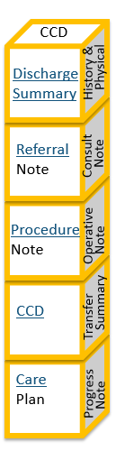
Comparisons
Different document types tell
different types of stories.

Slide 57
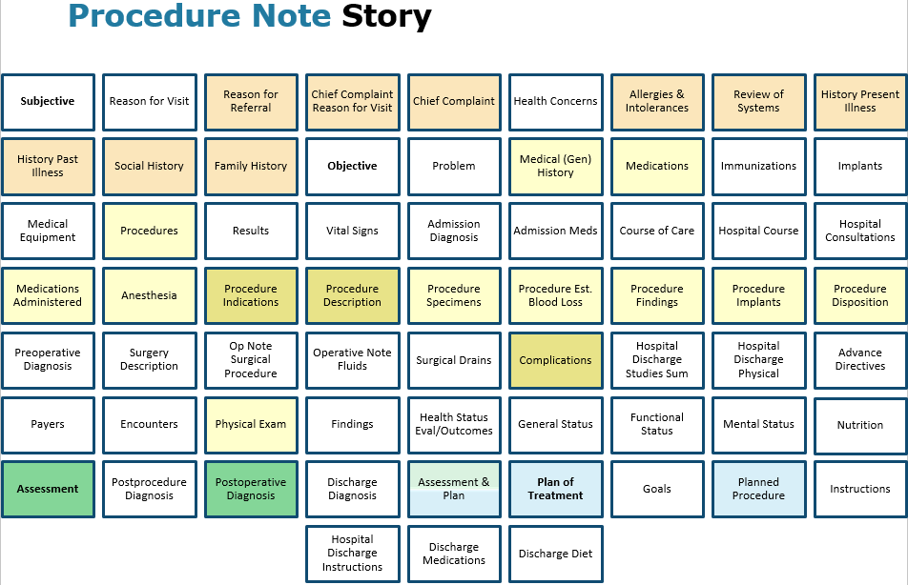
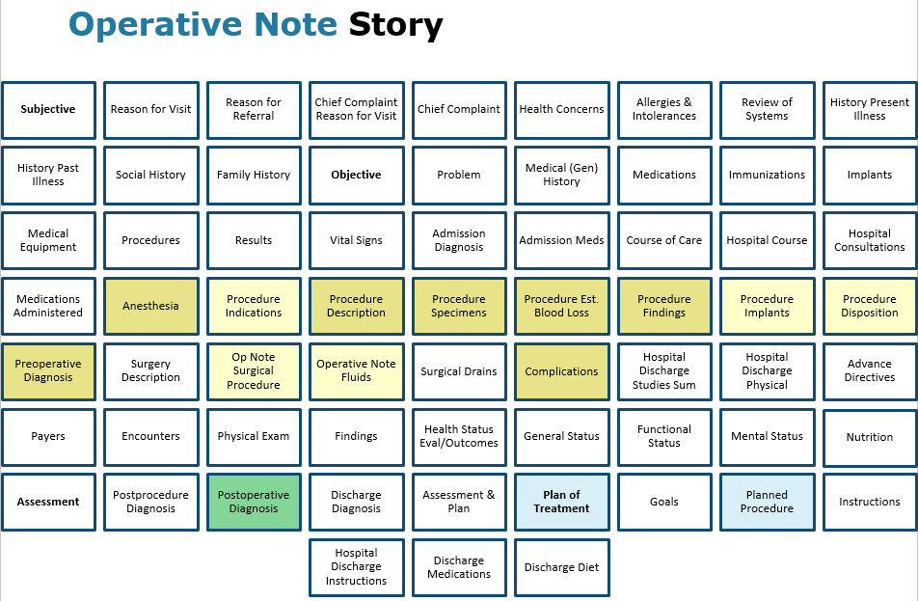
Comparison
A Procudure Note documents a procedure, typically less involved than a surgical operation, such as outpatient injections.
An Operative Note documents a surgical procedure, including indication for surgery, anesthesia, details of the procedure, complications, and disposition of the patient at the end of the operation.

Slide 58
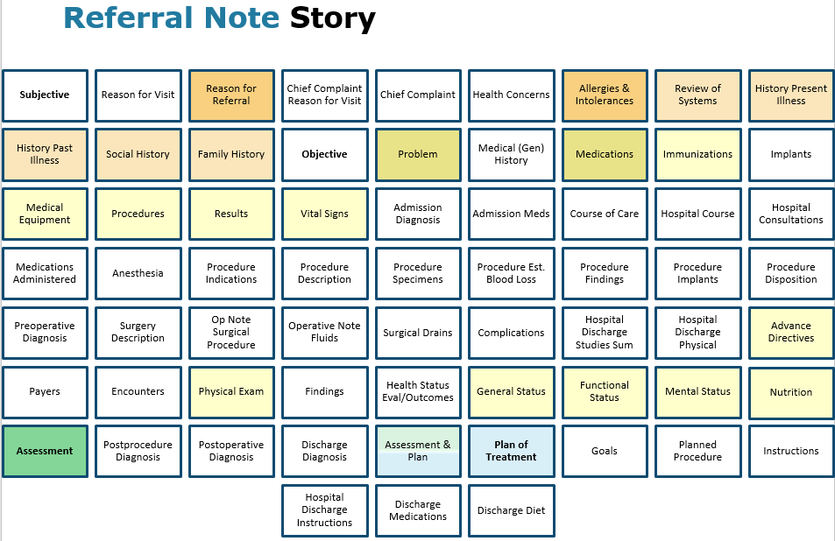
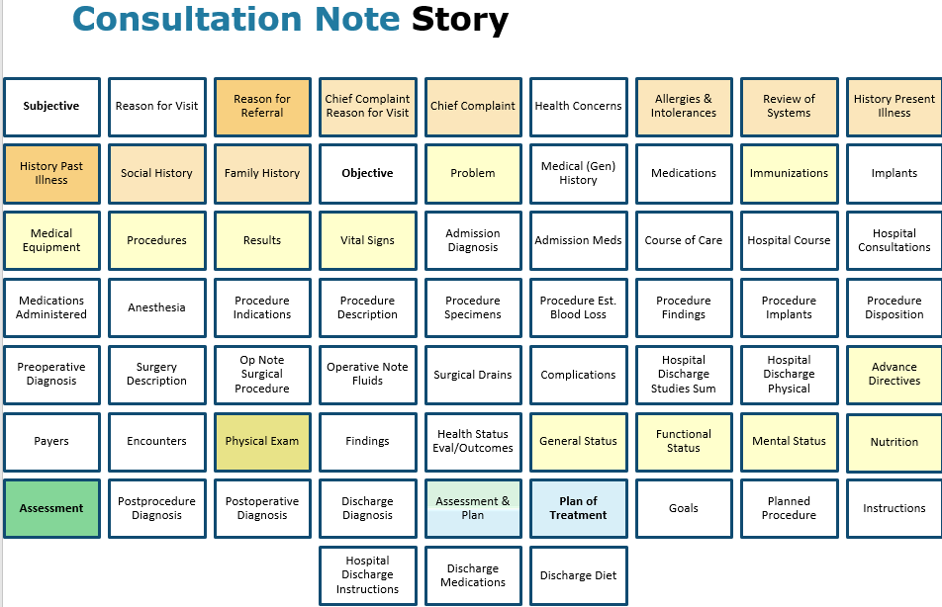
Comparison
A Referral Note communicates pertinent information from a provider who is requesting services of another provider of clinical or non-clinical services.
A Consultation Note describes the findings and treatment recommendations of a consulting physician, often written as a letter to the referring physician.
The Consultation Note is used to close the loop on a referral or to keep referring/primary physician informed about findings, assessments, and treatment plan.

Slide 59
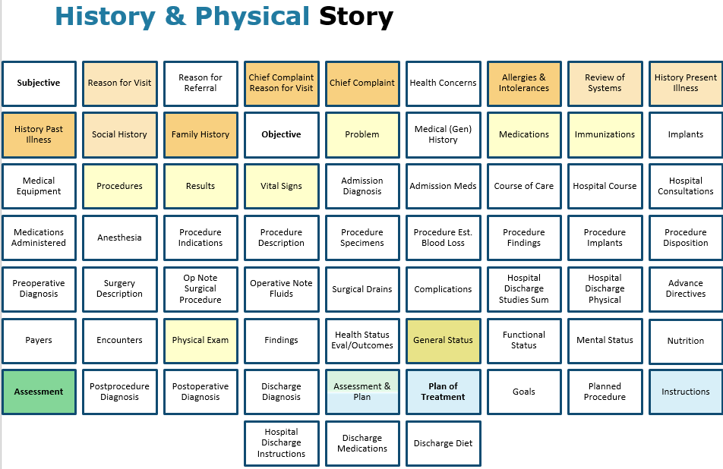
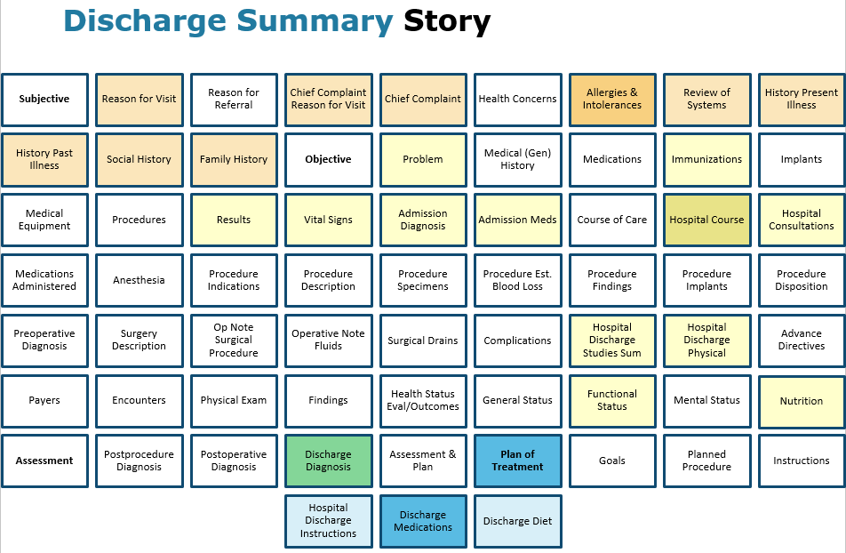
Comparison
The Discharge Summary document is produced after a hospitalization.
The H&P is required within 24 hours of hospital admission.
The H&P is written on a patient's initial outpatient encounter and again at yearly physical.
What would be the correct document type following an outpatient “sick visit”?

Slide 60
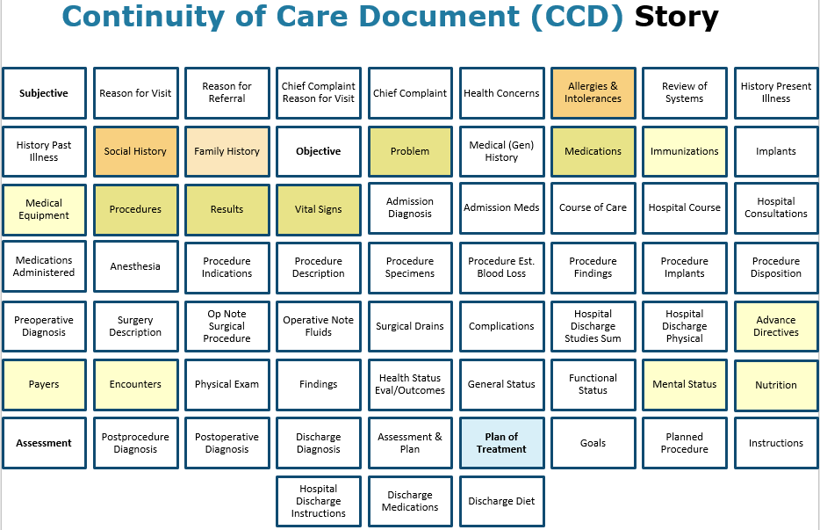
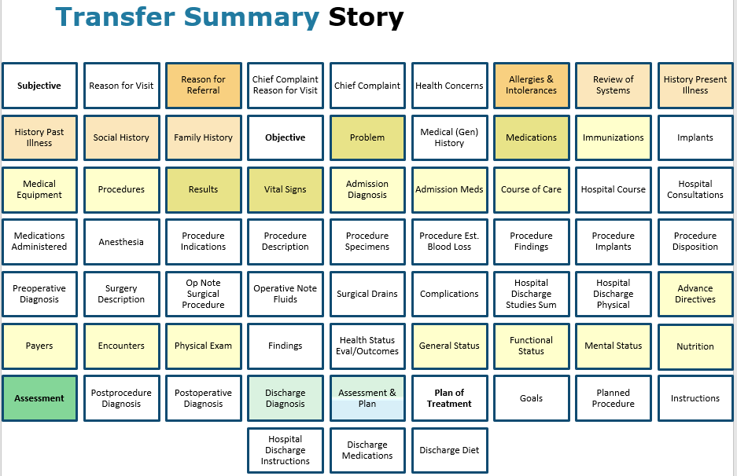
Comparison
A CCD records information over a range of time that likely includes multiple encounters.
A Transter Summary records information that needs to be shared between care providers when a patient moves between health care settings.
The encompassing encounter for a Transfer Summary is the encounter from which the transfer in initiated.
What would be the correct document type following an outpatient “sick visit”?

Slide 61
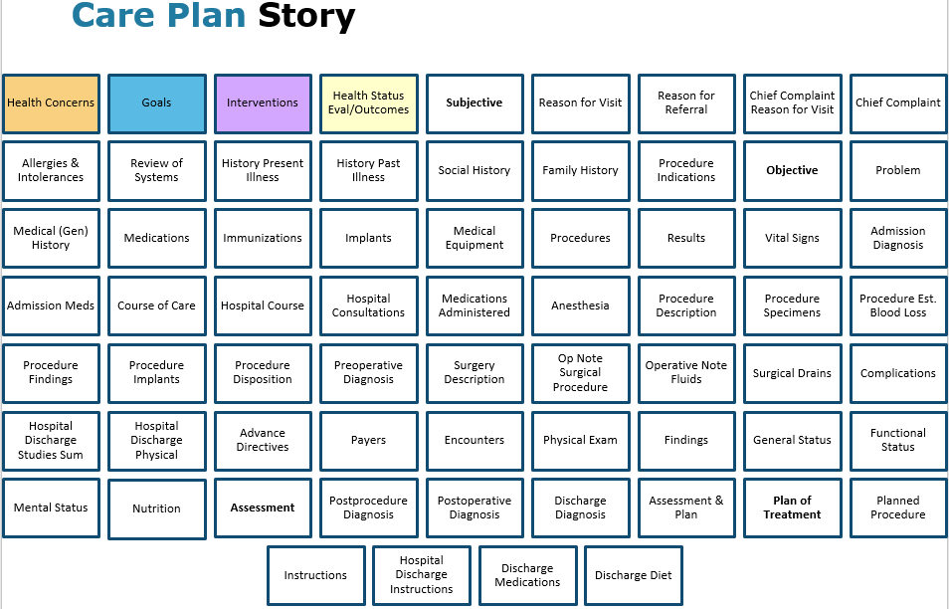
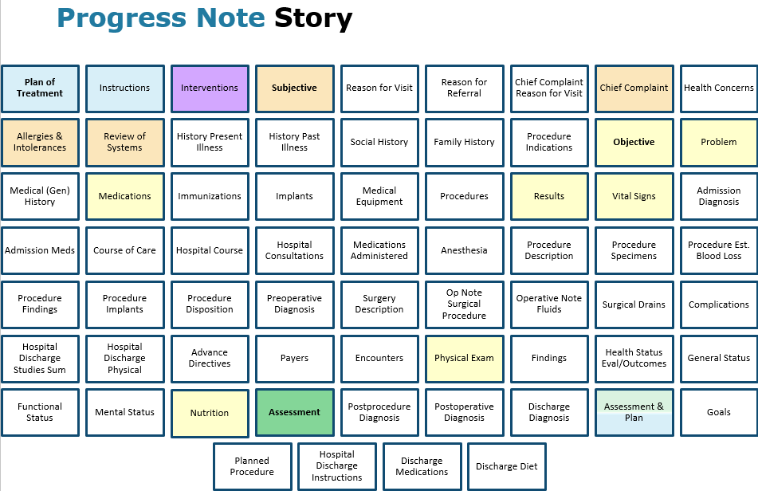
Comparison
A Care Plan document records a snapshot, at a point in time, of the person’s dynamic care plan.
In an acute care setting, progress notes are written daily.
In the outpatient setting, progress notes are written for followup or recheck appointments
In a Progress Note, how would you distinguish the previously established plan which is guiding the interventions made during the care encounter versus the updated plan established at the end of the encounter?

Slide 62

The Longitunidal View
Visualize the information in motion over time.

Slide 63

The HIT Ecosystem Generating & Sharing Information
Healthcare
Care Plan
Self Care
Secondary
Uses

Slide 64
How does Care Plan information work together? The same information organized in a “Plan Perspective”
HL7
Care Plan
Domain
Analysis
Model
(2016)
Interoperability:
Syntax
Structure
Semantics
Process
Care Plan Standards define ‘containers’ to capture and relate care plan information (Structure & Semantics)
Health concern/problem (Needs/Issues)
Health goal (Goals/Objectives)
Intervention/activity (Actions)
Evaluation/outcomes (Progress toward the associated Goal)

Slide 65
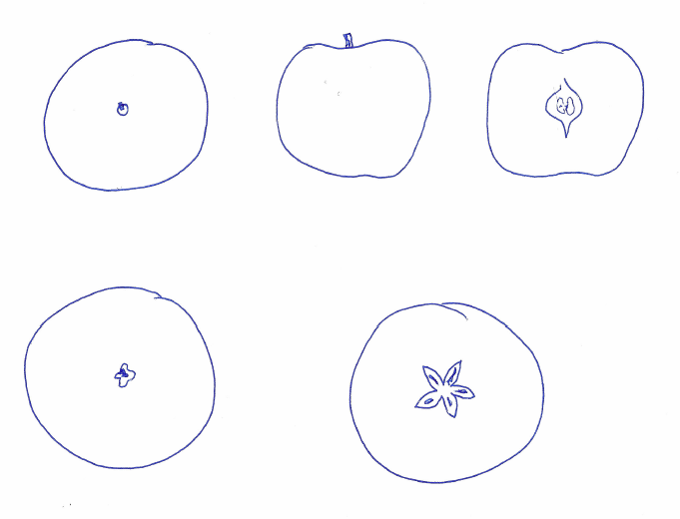
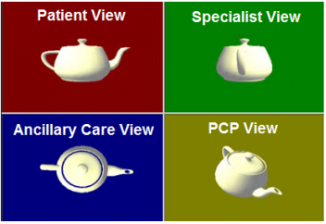
The same information, from a different perspective.
Different views that all make sense together.
The same information, communicated in different ways, but the different views are consistent when considered together.
This Is an Apple.

Slide 66
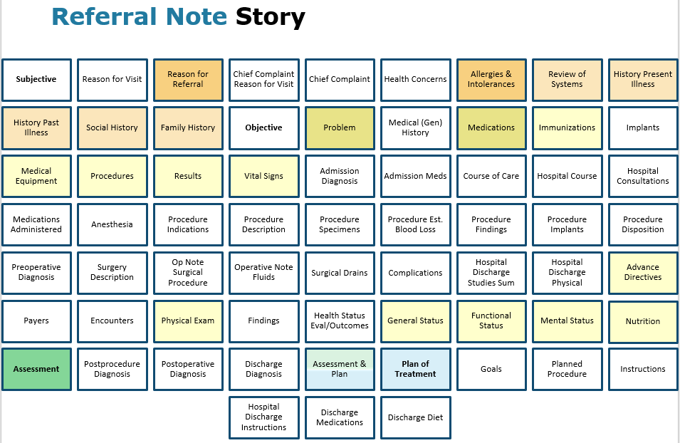

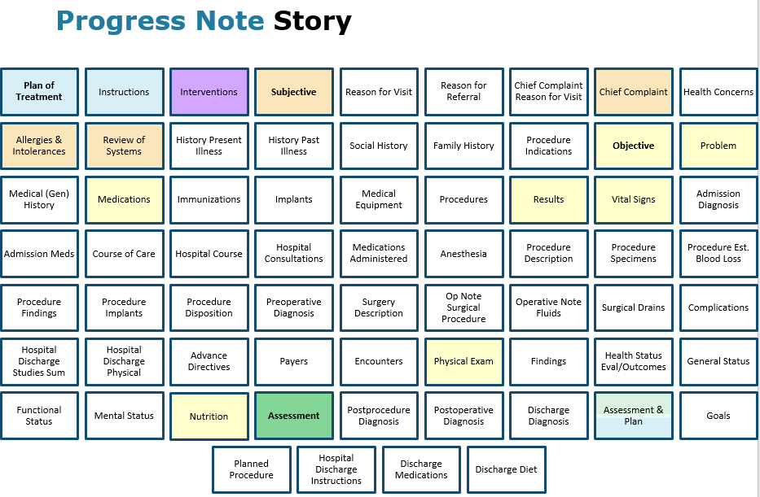

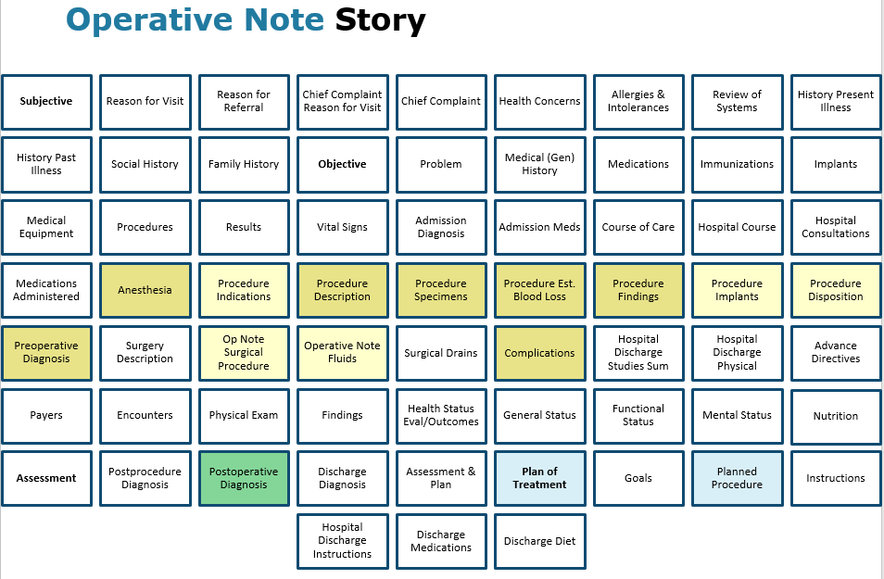
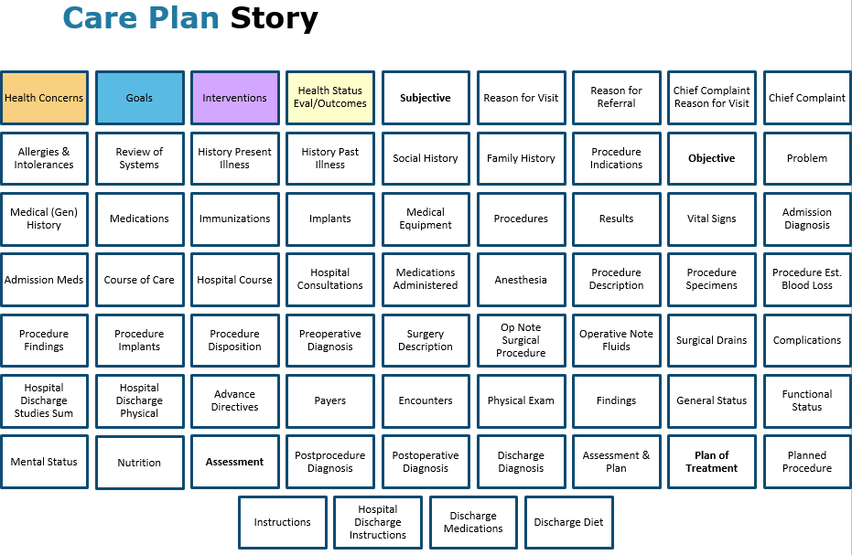
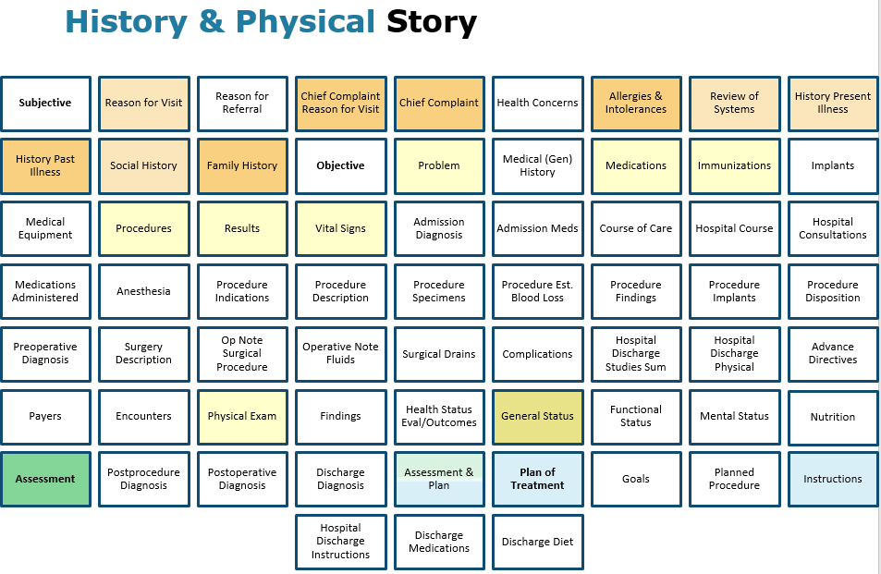

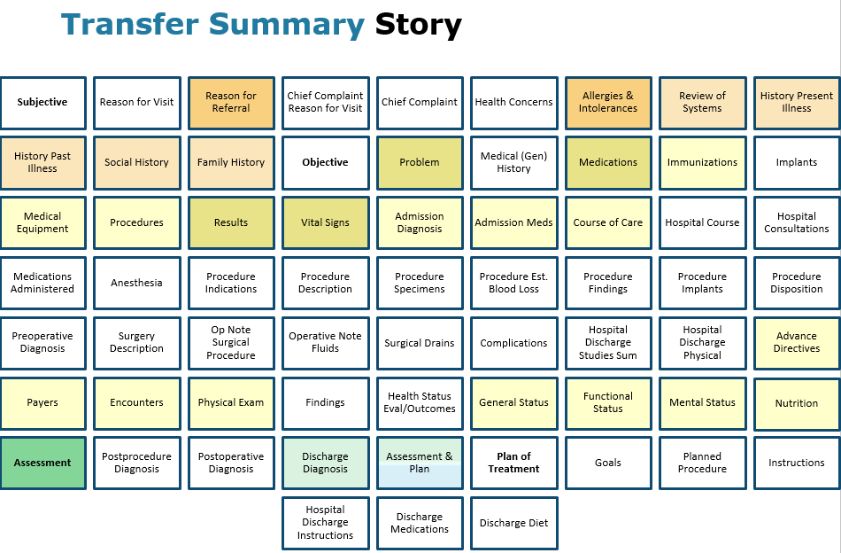


Slide 67
C-CDA R2.1 Templates – SOAP Perspective
REORGANIZED to TELL THE STORY
Health Concerns
Interventions
Results
Vital Signs
Medications
Immunizations
Procedures
Medical Equipment
Hospital Consultations
Medications Administered
Procedure Implants
Surgery Description
Surgical Drains
Encounters
Goals
Plan of Treatment
Planned Procedure
Instructions
Hospital Discharge Instructions
Discharge Medications
Discharge Diet
Health Status Eval/Outcomes

Slide 68
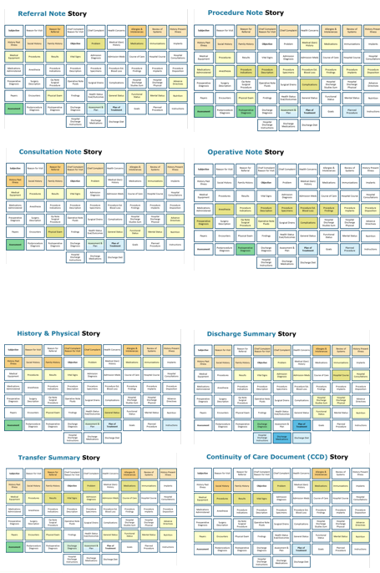
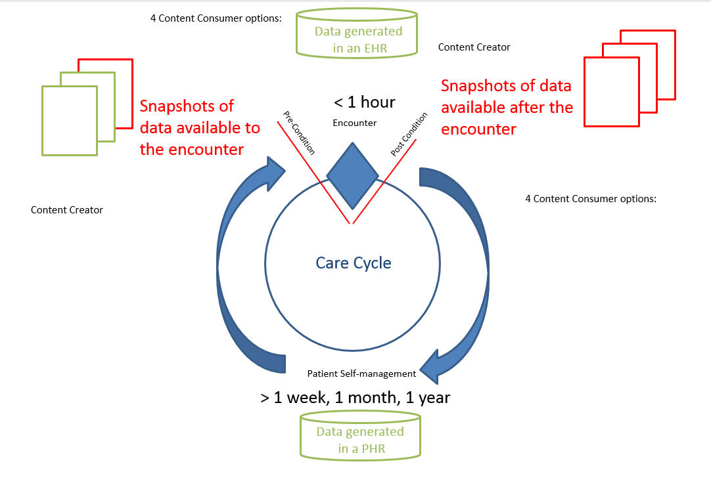
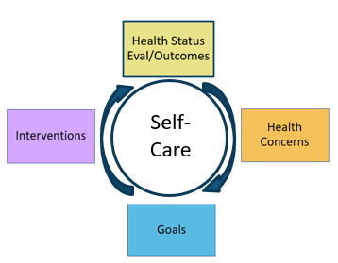
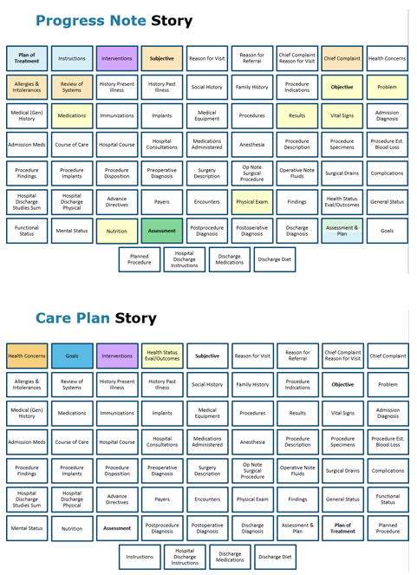

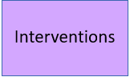


“Longitudinal” Cycles of Care, Care Management and Self Care
PGHD
Self Care
+ Secondary Uses
Day-by-day
Care Plan Management
> 1 day, 1 week, 1 month, 1 year
Care Plan Cycle
68

Slide 69
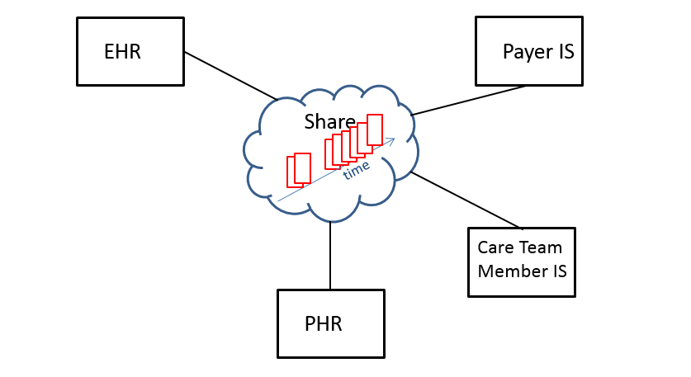
Zooming Back Out…
Secondary
Use
Payer IS

Slide 70
The HIT Ecosystem Generating & Sharing Information
Quality Measures
Healthcare
Care Plan
Self Care
Practice Efficiency
Empowered Patients
Secondary
Uses
Research
Public
Health
Focus on Wellness
Evidence-based Care

